Slide 1

Finger gesture recognition during hand movement with smart skin technology and deep learning
Presented by: Gal Babayoff & Tomer Roditi Supervised by: Prof. Yael Hanein
Biomedical Engineering Department, Faculty of Engineering, Tel-Aviv University

Slide 2
Gesture Recognition Aim
Finger gesture recognition has numerous applications in fields such as healthcare, gaming, and robotics.
Smart skin technology and deep learning offer a promising solution over traditional approaches.
Notes:
To achieve the most accurate and reliable results
cameras, videos, or gloves.
Electromyography

Slide 3
WHAT WE ARE WORKING ON
THEM
US
sEMG-based finger gesture recognition in a fixed hand position
Expand the work to recognize finger gestures during free movement
Notes:
This approach expands beyond the previous project, which was limited to static hand positions

Slide 4
Methods
Data collection
01
02
03
Wireless sEMG system
Data analysis
Notes:
composed of three primary components

Slide 5
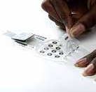
Wireless sEMG system
X-trodes Inc. system contains 16 electrodes and a data acquisition unit.
Notes:
Nanotechnology
EMG = Electromyography
Bluetooth + sd – sampling rate 4000 kHz

Slide 6
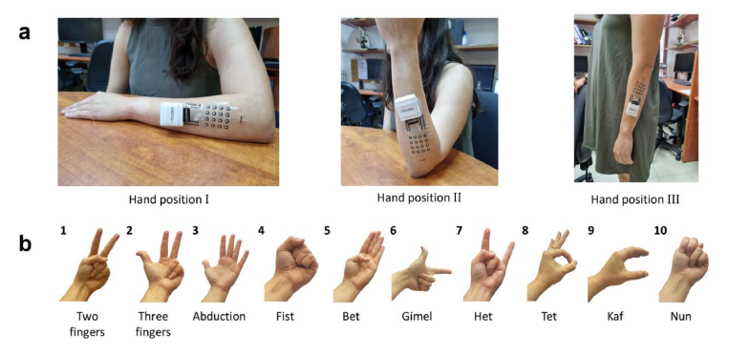
Data collection
Notes:
2 sessions
4 hand positions
10 gestures
10 repetitions
Total 800 gestures per subject

Slide 7
Data analysis
Features extraction
Filtering
Segmantion
Model
Notes:
Filter – reduce power line interferences and remain within the EMG range.
Segmantaion – into active time windows -> sub windows

Slide 8
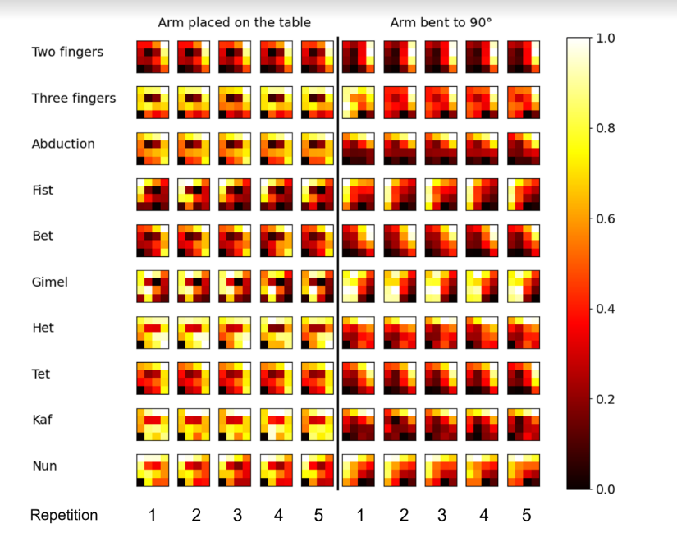
Features extraction
Rms maps of one subject.
Each row represents
one hand gesture, and the columns represent different repetitions of the same gesture.
Notes:
Each sub-window: calculate the root-mean-square RMS per channel
Result in heat maps of 16 value (one to each electrode).

Slide 9
Data analysis
Features extraction
Filtering
Segmantion
Model
Notes:
Data pipeline
Model pipeline
Classification tasks

Slide 10
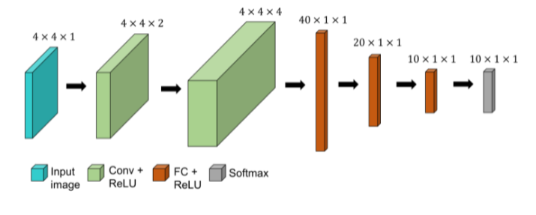
Model Architecture
Notes:
Input size (matches the features map), output size matches the number of classes (different hand gestures)
Batch normalization and drouput layers
Not so deep, not sophisticated! -> Lots of room for improvements as the tasks becomes more complicated

Slide 11
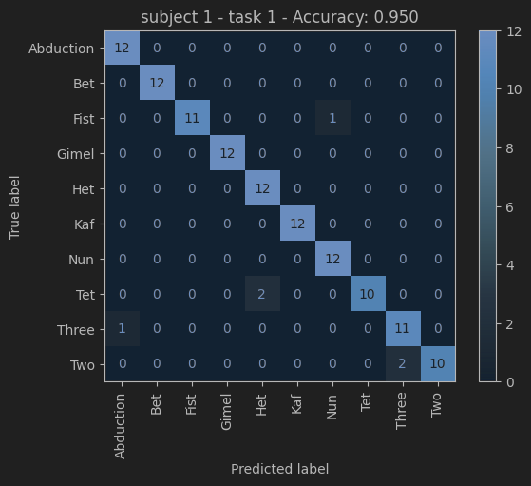
Classification tasks
2 sessions
3 positions – I,II,III
10 finger gestures
Train/test - 80/20 %
accuracy - 95%
Notes:
- Reproducing last year results with the refactored code and simplified pipeline.

Slide 12
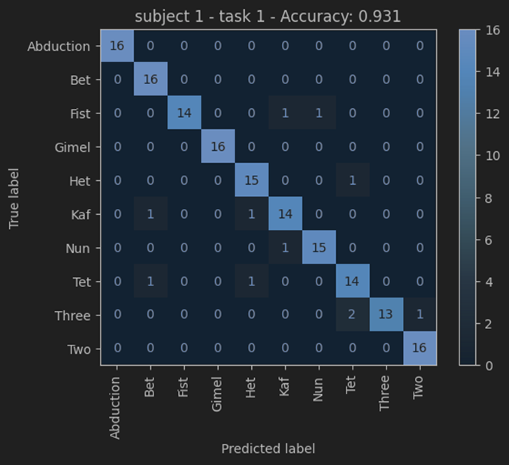
Classification tasks
2 sessions
4 positions – I,II,III,IIII
10 finger gestures
Train/test - 80/20 %
accuracy - 93%
Notes:
Adding our new position (moving hand)
Results are pretty much the same, no significant performance degradation.

Slide 13

Classification tasks
2 sessions
1 position – IIII
10 finger gestures
Train/test - 80/20 %
accuracy - 100%
Notes:
- Just to show that the movement of the hand doesn’t affect the quality of the data

Slide 14


Classification tasks
2 sessions
4 positions – I,II,III,IIII
10 finger gestures
Train/test – train on session 1, fine tune with 30% of session 2, test on 70% of session 2
accuracy - 90%
Notes:
- Cross session fast learning
- Improvement from last year, we are using only the same subject data to pretrain the model.

Slide 15

So Far
Similar achievements in
static positions
model per subject
High accuracy for gentle
Movements

Slide 16

Future
Collect more data
Develop new pipelines and models for broader movements
Notes:
- Need to define a new protocol for data collection with broad hand movements

Slide 17
Future
Integrate accelerometer data.
Models' architectures.
Static positions collection as a database.
Notes:
Transformers architecture
Continuous data segmentation (for online use)

Slide 18

THANKS

Slide 19
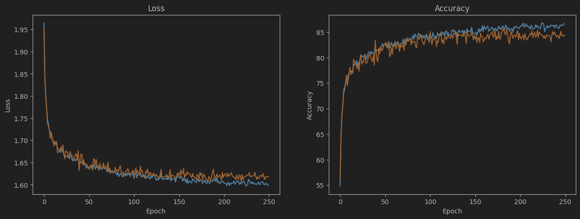
Loss VS. Accuracy

Slide 20
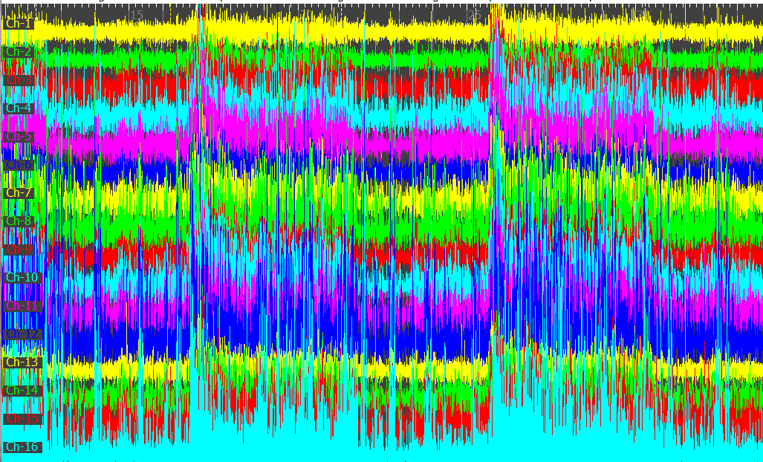
Pos |||| signal

Slide 21
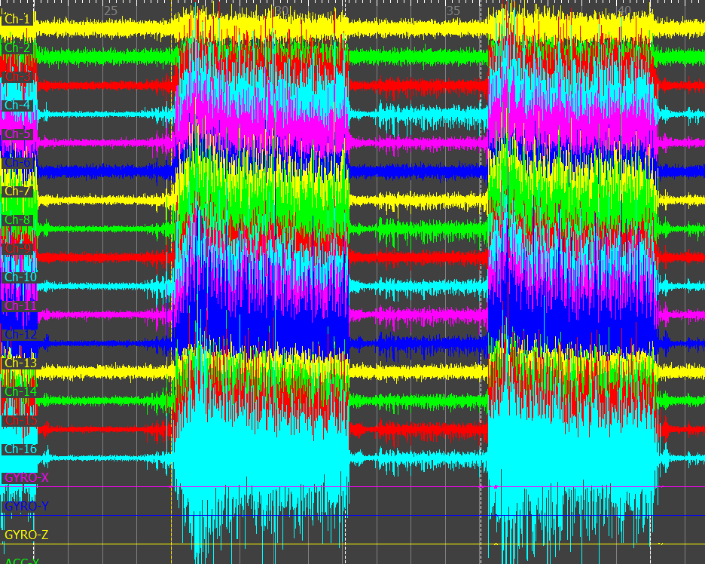
Pos ||| signal

